Slide 1
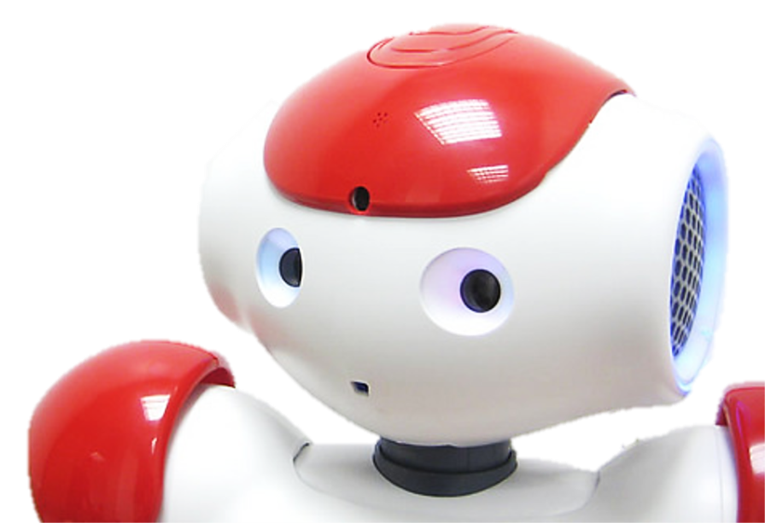
Overview
Introduction to Robotics
Sensors of NAO
Effectors of NAO
Programming a NAO
Applications – Robotutor
Notes:
# Slide 1.
{behavior|HelloEverybody}
Hello everyone! \pau=500\ Welcome back!
\pau=200\
{behavior|LegRandomMove}
{behavior|FirstMe}
In the first part, I introduced some basic concepts of robots, and sensors.
{behavior|LegRandomMove}
Now I will talk about effectors, programming, and applications.

Slide 2
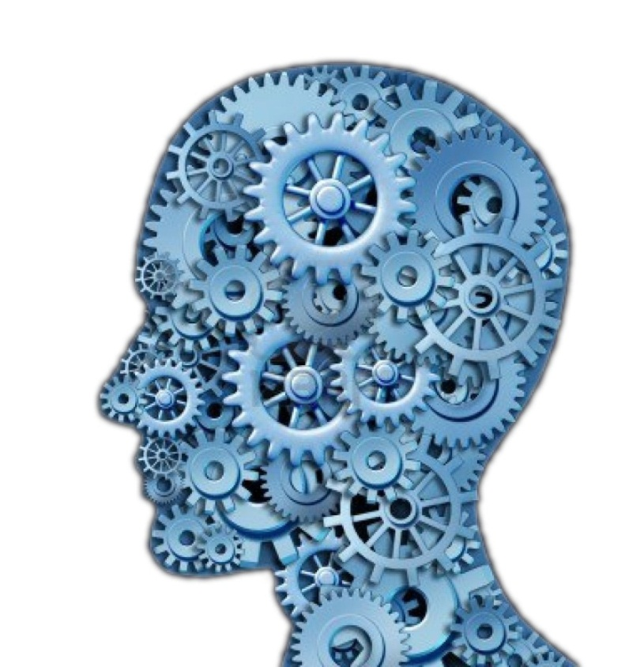
Processing - from input to output
Examples:
Processing maps input (sensor data) to output (actuator control).
State extraction (localization & navigation)
Computer Vision for understanding images
Sensor Fusion for a sense of motion
Notes:
# slide 23 Processor
{behavior|Twinkle}
{slide}\pau=1000\
{behavior|YouAndMe}
Sensors give you, and me, a lot of information about our surroundings,
{behavior|State}
{behavior|LegRandomMove}
but we need to determine what we do with this information. I think the rules that
{behavior|FromAToBLeft}
map input to output have been discussed, previously during the course.
{behavior|Propose}
{behavior|LegRandomMove}
In a robot, the hardware that does this mapping is called, the processing unit.
{behavior|Convince}
Processing units are helpful for determining states in the world,
{behavior|LegRandomMove}
for example, my exact location and how I should navigate through a map,
{behavior|FromAToB}
to get from one point to another.
{behavior|RotatingCapisce}
{behavior|LegRandomMove}
Processing units also help me understand the images I receive from my cameras, to detect things like faces and objects nearby.
{behavior|LegRandomMove}
Or for example sensor fusion, which combines the input
{behavior|FromAToB}
from a gyroscope, accelerometer and compass into a single, better orientation value.
{behavior|LegRandomMove}
which helps me determine where I am, and how I am moving.

Slide 3
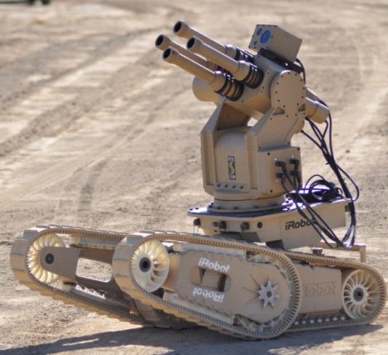
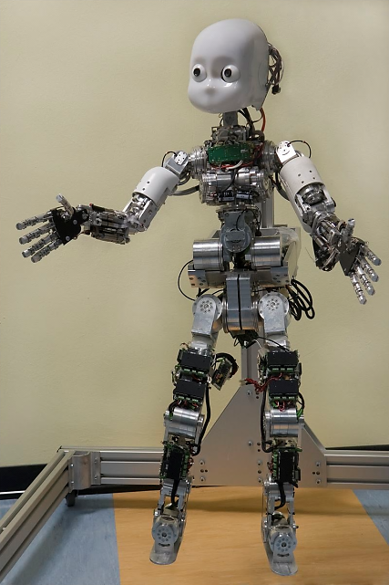
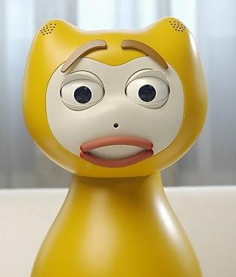
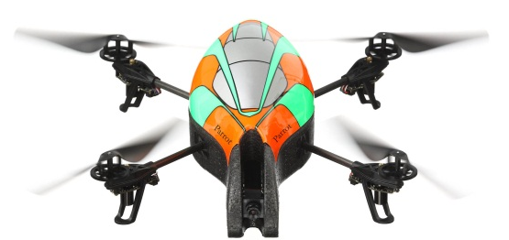
Effectors
Basically, anything to manipulate our world
Mobile: wheels, track, leg
Action: legs, grippers, head, facial action units, propeller
Temperature: heaters
Audio: speakers
Weapon: gun
Color: lights
Notes:
# slide 24 Effectors
{behavior|Twinkle}
{slide}\pau=1000\
When the processing unit has
{behavior|OneTheOther}
{behavior|LegRandomMove}
processed the input, a decision follows, which would usually mean.
{behavior|Clap}
I have to move parts of my body. This is done using effectors.
{behavior|Propose}
{behavior|Balance}
An effector is basically anything to manipulate our world, for example my arms, my legs, and my speakers, etcetera.
{behavior|PushAsideBoth}
Let's have a short look at what I can actually do with effectors.

Slide 4
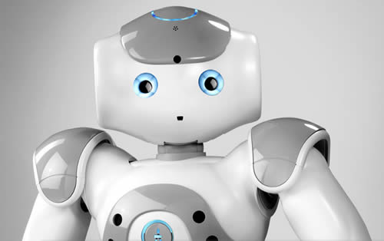
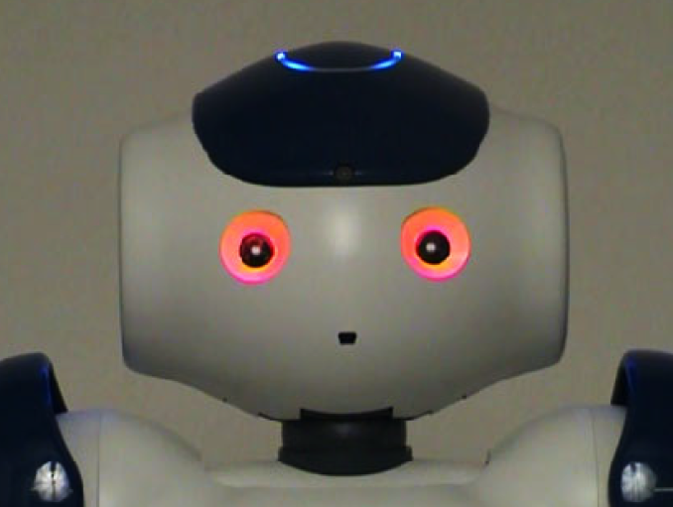
Head
Looking direction
Tracking face
Tracking sound source
Gaze
Show my attention
Head gesture:
nod
shake
dance
Eye LED Expression
Notes:
# Slide 25 Head
{behavior|Twinkle}
{slide}
\pau=1000\
{behavior|HandOver}
A head is probably, the most important part for humanoids. For me, despite that many important electronic components,
{behavior|ShowMic}
are inside my head. its movements also help me
{behavior|LookAround}
to track objects that interest me.
{behavior|LegRandomMove}
My gaze direction also indicates my attention.
{behavior|LegRandomMove}
Of course, head movements are essential to some gestures like
{behavior|Nod}
nodding and shaking head, and to dance.
# show blue, red
The lights in my eyes are also useful
{behavior|Wink}
for showing emotions.
\pau=2000\

Slide 5
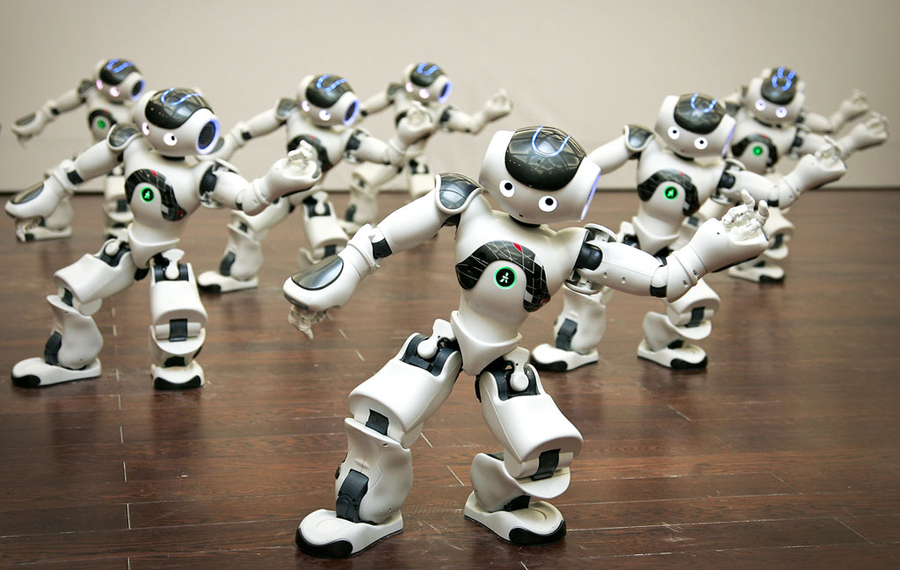
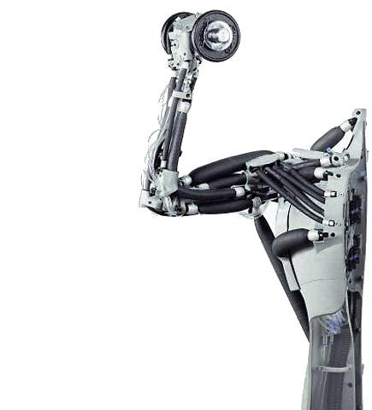
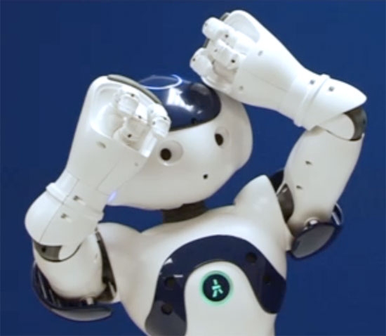
Arm
Grab objects
Gesture
Support body when standing up from a sitting position
Soccer: goal keeper
Dance
Game
Notes:
# Slide 26 arms
{behavior|Twinkle}
{slide}\pau=1000\
{behavior|LegRandomMove}
{behavior|Me}
One of my important effectors is my arm.
{behavior|Capisce}
Although I only have three fingers for each hand, I can still grab objects.
{behavior|RotatingCapisce}
I can also use my arms to make gestures.
{behavior|LegRandomMove}
When I need to stand up, my arms also help me to support my body.
{behavior|Clap}
Arms are also necessary for entertainment like soccer, dance, and games.

Slide 6
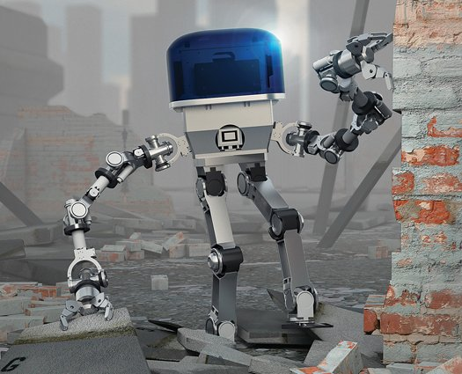
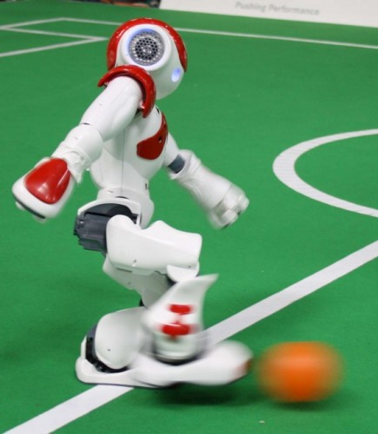
Leg
Stand
Move around
Jump
Play soccer: goal
Dance
Notes:
# Slide 27 leg
{behavior|Twinkle}
{slide}\pau=1000\
{behavior|Propose}
Legs are a representative feature for biped robots like me.
{behavior|LeanRight}
They support our body, enable us to stand, walk, and jump.
{behavior|Propose}
{behavior|LegRandomMove}
Legs have advantages in walking over complex terrains, where wheels can be easily stuck,
{behavior|HandOver}
{behavior|LegRandomMove}
for example, ruins caused by disasters.
{behavior|Spread}
However, compared to wheels, it is not easy to control my move accurately.
{behavior|LegRandomMove}
This is caused by the backlash of my joints and the slippage of my feet.
{behavior|HandOver}
{behavior|LegRandomMove}
As you might notice, I have been already standing at
{behavior|OneTheOther}
{behavior|LegRandomMove}
a different position, from where I started the lecture, although my leg movements were small.
{behavior|SpreadBoth}
As a result, it is difficult to control me to walk in a straight line.
{behavior|PushAsideLeft}
Legs are also important for entertainment.
Look at me! I am going to show you how I can stand on one leg, and, kick.
{behavior|Kick}
\pau=10000\
If my friends were here,
{behavior|Applaud}
I could even play soccer or dance with them.
\pau=500\

Slide 7
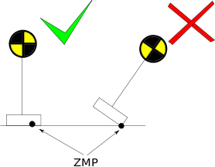
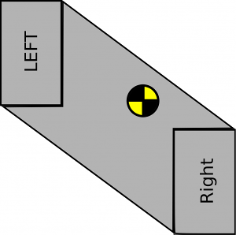
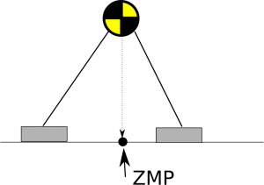
Body Balance - Zero Moment Point (ZMP) & Support Polygon
Zero Moment Point
A point where the total of vertical inertia and gravity forces equals zero
The center of pressure
Support Polygon
For me is the convex hull of my two feet
CoM must be inside the support polygon
Center of mass
(CoM)
Support
Polygon
Notes:
# Slide 28 - ZMP Support Polygon
{behavior|Twinkle}
{slide}\pau=1000\
{behavior|Balance}
Balence is a key aspect to the locomotion of biped robots.
{behavior|MeAndYou}
{behavior|LegRandomMove}
Let me introduce to you, some basic concepts of controlling my balance.
{behavior|Capisce}
{behavior|LegRandomMove}
The Zero Moment Point, Z M P, is the point on the robot feets, where the moments acting on the robot
{behavior|Weigh}
are balanced by an opposing moment from the ground.
{behavior|LegRandomMove}
{behavior|State}
If the Z M P is at the edge of the foot area or beyond it, the foot will tip over, and likely fall.
{behavior|LegRandomMove}
{behavior|HandOver}
To be simple, the support polygon of a robot is the convex hull of the footprints on the ground.
{behavior|ConvergeHands}
Under zero acceleration conditions, to keep the Z M P within the foot area, the center of mass of the robot body,
{behavior|LegRandomMove}
should be kept inside the support polygon,
{behavior|Capisce}
and if so, the robot will not rotate about the edges of the foot,
{behavior|ShowBody}
and will remain upright.
\pau=1000\

Slide 8
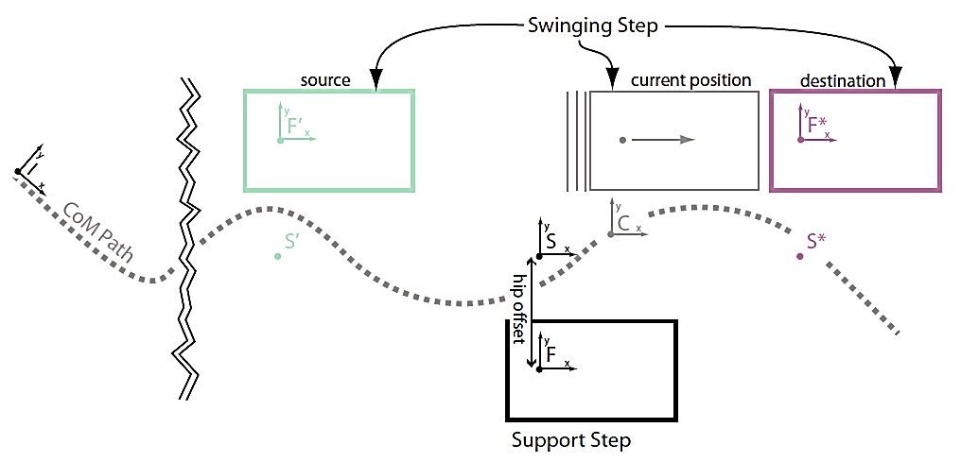
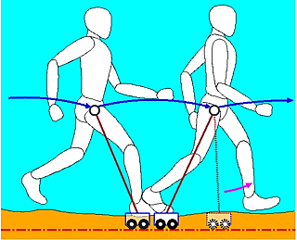
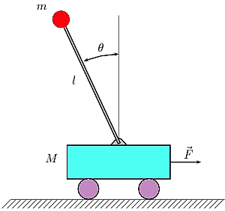
Walking Balance - Keep CoM Inside Support Polygon
ZMP
ZMP is moving during walking
Always keep CoM inside the support polygon during walking
CoM Path
Abstraction
Inverted pendulum cart
Linear Inverted Pendulum Model (LIPM): restrict the robot motion to the X-Y plane and prevent motion in the up down direction
Notes:
# Slide 29 - ZMP Support Polygon
{behavior|Twinkle}
{slide}\pau=1000\
{behavior|LegRandomMove}
In this slide, I will talk about balance during walking.
{behavior|Propose}
When I am walking, I select the next step very carefully.
{behavior|LegRandomMove}
to guarantee the Z M P of my body always inside the support polygon. As you can see,
{behavior|Walk}
my steps are small, and unlike a human.
\pau=1500\
{behavior|HandOverLeft}
{behavior|LegRandomMove}
More sophisticated walking style requires more complex algorithms, to keep the Z M P inside the support polygon.
{behavior|ProposeLeft}
{behavior|LegRandomMove}
One method is to model the locomotion of each leg, as an inverted pendulum cart, since most of the mass
{behavior|ShowBody}
aggregates in my upper body.
\pau=800\
{behavior|Capisce}
{behavior|LegRandomMove}
A widely used model is linear inverted pendulum mode, which constrains the motion of my body to the X Y plane.
{behavior|ConvergeHands}
Achieving position control of legs while making sure that, the Z M P is inside the foot area
{behavior|SpreadBoth}
{behavior|LegRandomMove}
is a whole research field on its own, so I will not provide further details in this lecture.
# summary
{behavior|Clap}
{behavior|LegRandomMove}
This is just what I can do with my effectors though, there are even robots that can juggle or play ping pong.
{behavior|No}
but I can not react fast enough.
{behavior|ShowBiceps}
{behavior|PushAsideBoth}
As you see, motors are not the only effectors that exist, but for me and most robots they are the most important ones, as they are essential to the movements of my body.

Slide 9
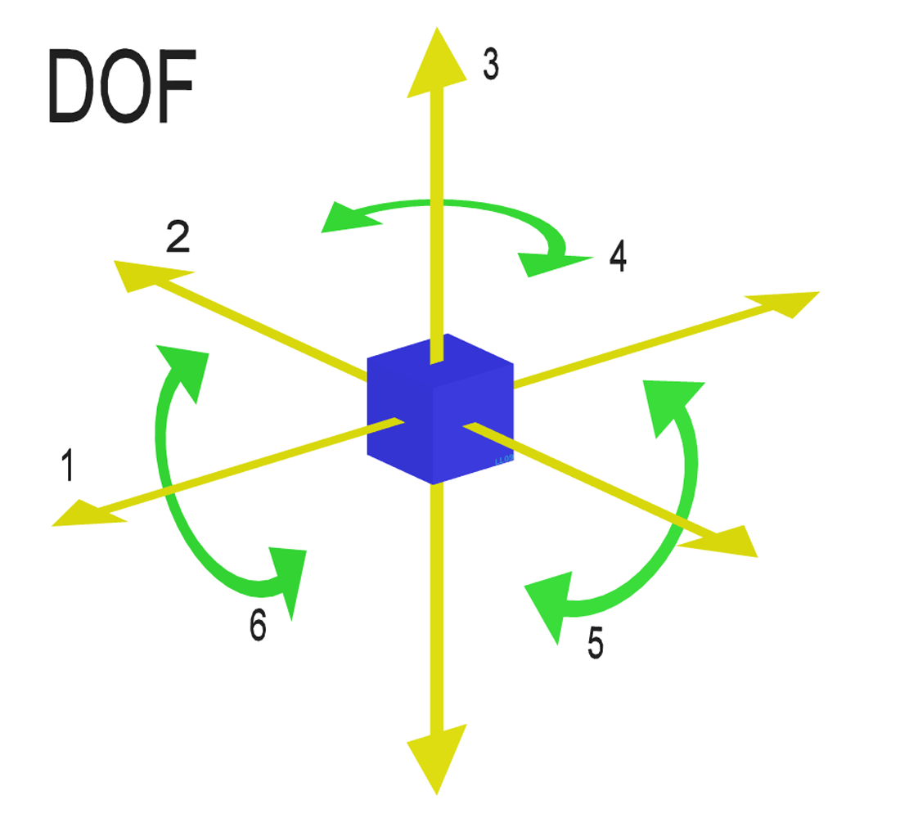
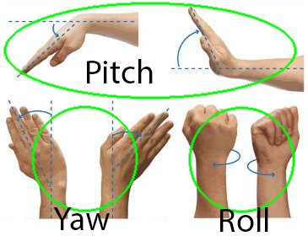
Degree of Freedom
A free object has 6 DOFs
3 DOFs of Translation (x, y, z)
3 DOFs of Rotation (pitch, yaw, roll)
Joints reduce DOF; bars cannot move freely
Limited by degrees of freedom (DOF)
No Wrist Yaw, Wrist Pitch
Only two joints (DOFs) for neck (head)
No waist joints
Fingers are coupled: only 1 active DOF!
Notes:
# Slide 30 - DOF
{behavior|Twinkle}
{slide}\pau=1000\
{behavior|YouAndMe}
{behavior|LegRandomMove}
Your arms and mine too, are limited by what we call degrees of freedom.
{behavior|Capisce}
A free object has six degrees of freedom, three for moving, and three for rotation.
{behavior|Convince}
{behavior|LegRandomMove}
A linkage, like my arm, is formed by several bars connected by joints.
{behavior|HandOverLeft}
Joitns reduce degrees of freedom, because the bars cannot move freely anymore.
{behavior|LegRandomMove}
They can only rotate around the joints. Take your wrist for example.
{behavior|LRUD}
You can rotate it up and down, left and right, and twist it, giving it three degrees of freedom.
{behavior|No}
{behavior|LegRandomMove}
My arm has even less degrees of freedom, because only some joints can rotate around three axes.
{behavior|CapisceLeft}
Some of my joints, like the three fingers of my hand, are controlled
{behavior|Tiny}
by only one motor, so it only has one degree of freedom.

Slide 10
How many degrees of freedom does a NAO arm have?
3
6
7
9
15
Notes:
# Slide 31 - Quiz DOF
{behavior|Twinkle}
{slide}\pau=1000\
{behavior|Motivate}
Let's see if you now understood this concept.
{behavior|PointForward}
{behavior|LegRandomMove}
How many degrees of freedom does my right arm have? Now, look at me carefully.
# Show
{behavior|ShowArmJoints}
\pau=10000\
\pau=10000\
#
{behavior|HandOver}
{behavior|LegRandomMove}
Now, I give you again 15 seconds to answer, so be quick.
{behavior|LookAround}
{behavior|LegRandomMove}
# Start timer
{slide}
# Wait for 15 seconds.
\pau=10000\
\pau=5000\
# Get results.
{slide}
\pau=2000\
# Hackfix to trigger the turningpoint choice command.
{behavior|LegRandomMove}
Hum, let's see.
{turningpoint choice | This is not true. | Yes, very good! | Not exactly. | Not exactly. | Well it seems there is no conclusive answer. I do admit, it is a difficult subject. }
# Show correct answer.
{slide}
\pau=500\
{behavior|Spread}
The correct answer was B.

Slide 11
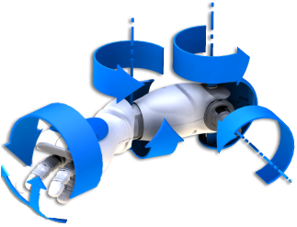
DOF Quiz Answer
Elbow Roll
Shoulder Roll
Wrist Yaw
Shoulder Pitch
Elbow Yaw
Finger
Notes:
# Slide 32 DOF answer
{slide}
\pau=500\
# better words?
{behavior|LegRandomMove}
{behavior|ShowArmJointsOneByOne}
Since my shoulder, can pitch, and, roll.
\pau=400\
my elbow, can roll,
\pau=300\
and yaw.
\pau=700\
{behavior|LegRandomMove}
my wrist, can only yaw.
\pau=2000\
and I have told you my fingers only have one degree.
\pau=2000\
{behavior|LegRandomMove}
{behavior|State}
This gives it a total of 6 degrees of freedom.
\pau=500\

Slide 12
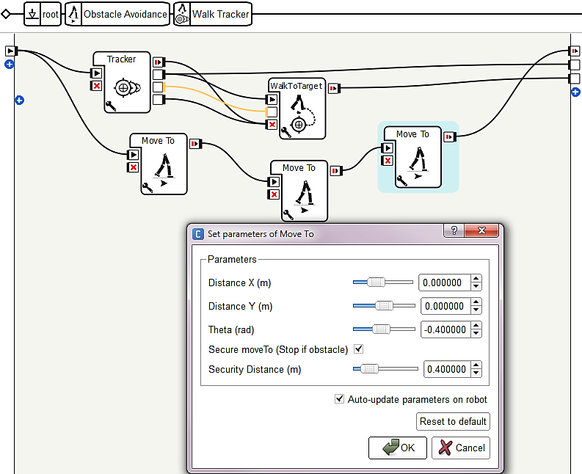
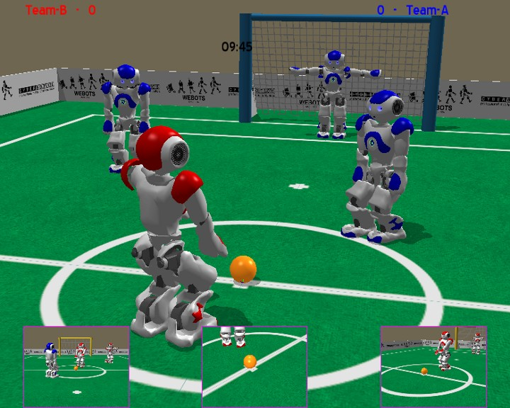
Programming
Choregraphe
Graph-flow based programming
Modular behaviors that can be called locally and remotely
Simulator
Notes:
# Slide 33 Programming
{behavior|Twinkle}
{slide}\pau=1000\
{behavior|Clap}
{behavior|LegRandomMove}
Now we have seen what I can do, with my sensors and effectors,
{behavior|Me}
let me give you a brief introduction to how you can program me.
{behavior|SpreadBoth}
Choregraphe is an excellent graph-flow based programming tool shipped with me.
{behavior|FromAToB}
{behavior|LegRandomMove}
You can drag boxes from libraries, and connect them to create your projects, as you can see on the right of the slide.
{behavior|Propose}
{behavior|LegRandomMove}
This type of programming is also called visual programming.
{behavior|OneTheOther}
{behavior|LegRandomMove}
Sometimes, you may need to change the code behind the boxes, or create your own boxes.
{behavior|HandOver}
{behavior|LegRandomMove}
You can use Python to code these boxes. Projects can be executed on a computer, and on the robot.
{behavior|PointRight}
Sometimes, actions you create might cause me to fall down.
{behavior|LegRandomMove}
It is therefore very useful that, there are also simulators available for a try-out.

Slide 13
Programming languages
C++
AL::ALTextToSpeechProxy tts("<IP of your robot>", 9559);
tts.say("Hello world from c plus plus");
Java
ALTextToSpeechProxy ttsProxy = new ALTextToSpeechProxy("<IP of your robot >", 9559); tts.say("Hello World from java");
Python
tts = ALProxy("ALTextToSpeech", "<IP of your robot>", 9559) tts.say("Hello world from python")
URBI
tts.say("Hello World from urbi")
Notes:
# Slide 34
{behavior|Twinkle}
{slide}\pau=1000\
{behavior|PushAsideBoth}
{behavior|LegRandomMove}
A-P-I's to the A L modules provided with Nao Qi framework, are available for customized applications.
{behavior|State}
This slide shows an example of text to speech module.
{behavior|HandOver}
{behavior|LegRandomMove}
You can also use various programming languages, including c plus plus, java,

Slide 14
Programming languages
Matlab
tts = ALTextToSpeechProxy('<IP of your robot>', 9559); tts.say('Hello World from matlab');
C#
TextToSpeechProxy tts = new TextToSpeechProxy("<IP of your robot>", 9559); tts.say("Hello World from c sharp");
VB
Dim tts As TextToSpeechProxy = New TextToSpeechProxy("<IP of your robot>", 9559) tts.say("Hello World from visual basic")
F#
let tts = new TextToSpeechProxy("<IP of your robot>", 9559) tts.say("Hello World from f sharp")
Notes:
# Slide 35
{slide}
\pau=500\
{behavior|LegRandomMove}
c sharp, and even matlab to create your applications. They are all supported by our SDK libraries now.
{behavior|Propose}
{behavior|LegRandomMove}
However, only c plus plus and python are supported by the Linux system on the robot.

Slide 15
Which languages are supported on the robot?
C++ & C#
Java & Python
C++ & Java
C++ & Python
9
Notes:
# Slide 36 - Quiz Programming Language
{behavior|Twinkle}
{slide}\pau=1000\
# question
{behavior|Motivate}
Let's see if you are now clear about the programming of a NAO.
{behavior|HandOverLeft}
{behavior|LegRandomMove}
Which languages are supported on the robot?
#
{behavior|Convince}
{behavior|LegRandomMove}
Now, I give you again 10 seconds to answer, so be quick.
{behavior|LookAround}
{behavior|LegRandomMove}
# Start timer
{slide}
# Wait for 10 seconds.
\pau=10000\
# Get results.
{slide}
\pau=2000\
# Hackfix to trigger the turningpoint choice command.
{behavior|LegRandomMove}
Hum, let's see.
{behavior|LegRandomMove}
{turningpoint choice | This is not true. | Not exactly. | Not exactly. | Yes, very good! | Well it seems there is no conclusive answer. I do admit, it is a difficult subject. }
# Show correct answer.
{slide}
\pau=500\
The correct answer was D.
{behavior|State}
{behavior|LegRandomMove}
Only the c plus plus and python are supported by the linux system on the robot.

Slide 16
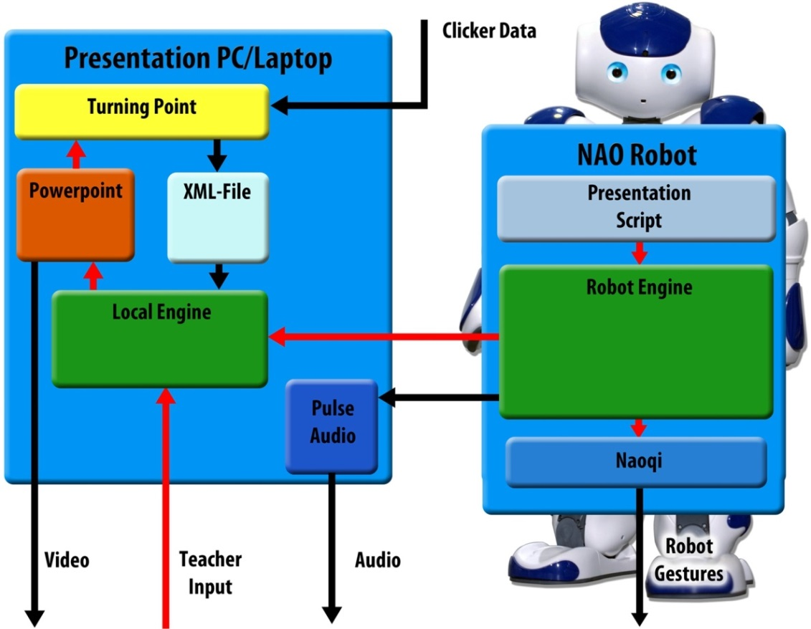
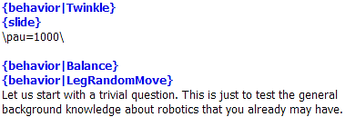
Robotutor Project
Script engine on the robot
Flexible script
Capable to run independently
Multimedia access
PowerPoint slide control
Classroom speaker
Interact with students
Respond to answers
Physical interaction
Script
interaction
Control flow
Data flow
If you are interested
Contact: k.v.hindriks@tudelft.nl
Notes:
{behavior|LegRandomMove}
{behavior|Me}
Finally, I will briefly introduce the Robo Tutor project.
\pau=1000\
{behavior|First}
Thanks to the script engine, that is part of my system,
{behavior|LegRandomMove}
{behavior|SpreadBoth}
many different scenarios can be designed for me to perform.
{behavior|YouAndMe}
{behavior|LegRandomMove}
Right now, I am a robot tutor, teaching you about robotics. However, I can also act in a theater, using the same system.
{behavior|Spread}
{behavior|LegRandomMove}
As you can see on the left bottom of the slide, the script is very intuitive.
{behavior|Propose}
{behavior|LegRandomMove}
With such a script, you can easily orchestrate my speech, actions, slide control, et cetera.
{behavior|LegRandomMove}
{behavior|SpreadBoth}
But don’t forget, I also need behaviors that need to be created, and synchronized with my speech, and the other actions that I perform. There are several concurrent threads, that need to be managed!
{behavior|LegRandomMove}
{behavior|OneTheOther}
Scripts can be stored both on a computer or in my system,
{behavior|Me}
{behavior|LegRandomMove}
and I can act using a script in my system,
{behavior|PushAside}
without another computer.
{behavior|LegRandomMove}
However, at least for now, a computer
{behavior|Propose}
is required for the slides and quizzes.
{behavior|LegRandomMove}
{behavior|Clap}
Thanks to the turning point technology, I can check,
{behavior|YouAndMe}
{behavior|LegRandomMove}
how well you understood the content I just taught,
{behavior|HandOver}
{behavior|LegRandomMove}
and provide more explanation on things, that were not clear.
{behavior|State}
{behavior|LegRandomMove}
My voice can also be transferred to a computer, and amplified, using the classroom speakers.
{behavior|ShowBody}
{behavior|LegRandomMove}
I am still growing. More and more functions will be added to me.
{behavior|Applaud}
{behavior|LegRandomMove}
Plans are for me to interact more and, for example, answer open questions that students ask directly, using a question-answer system.
{behavior|LegRandomMove}
{behavior|YouAndMe}
If you are interested in this project, please contact my boss, Koen Hindriks.

Slide 17
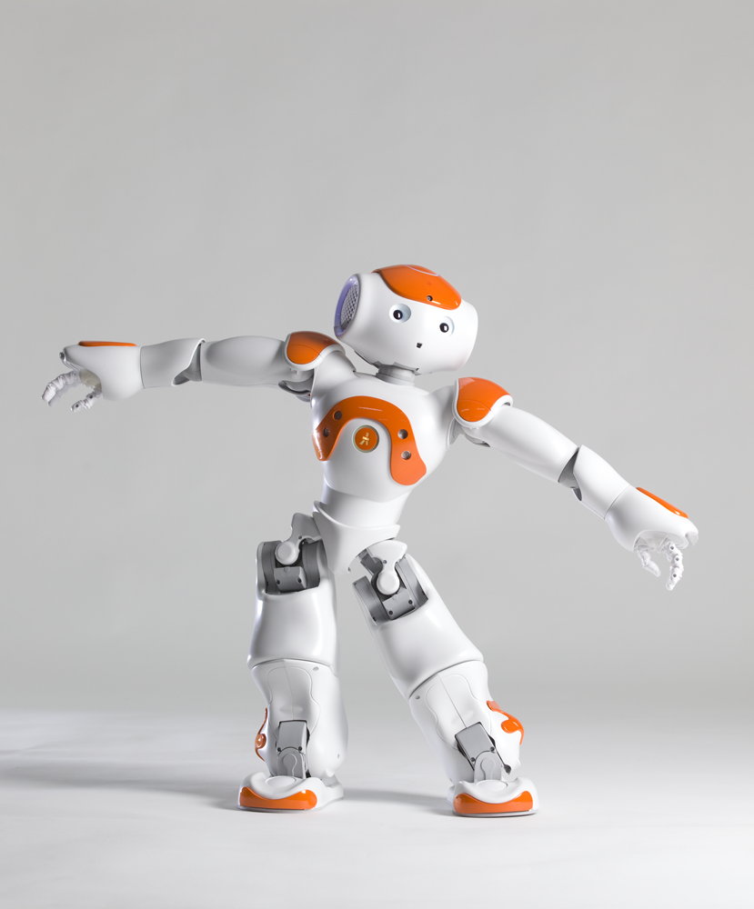
Thank you for your attention!

